Slide 1
Nonlinear Equations
Jyun-Ming Chen

Slide 2
Contents
Bisection
False Position
Newton
Quasi-Newton
Inverse Interpolation
Method Comparison

Slide 3
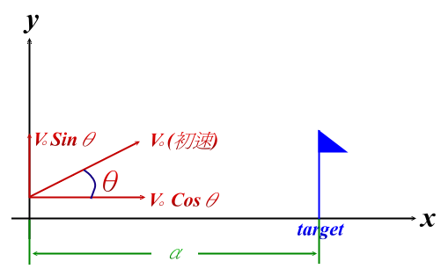
The Shooting Problem
Given V₀, adjustθto hit target
d

Slide 4
Solution 1
trial & error
  An intuitive interval bisection
Notes:
Prime, dot, hat, …

Slide 5
Solution 2: Convert to Mathematical Problem
Flying distance is a function of angle, or
  Dist = f (θ)
Find θ* such that
  f(θ*) = d
What is f(θ)?

Slide 6
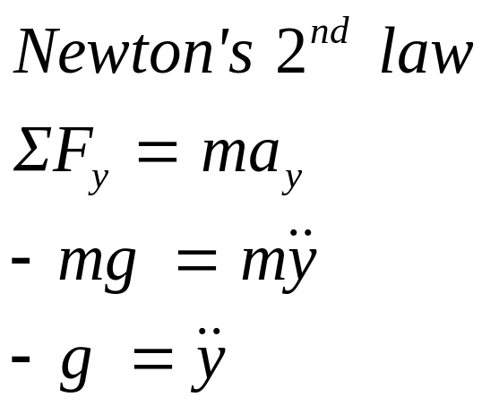
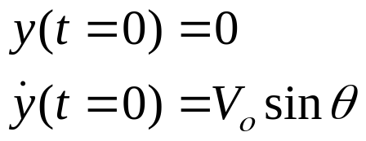
From your high school physics
y
θ
x
m
2nd order ODE
Initial value problem
mg

Slide 7
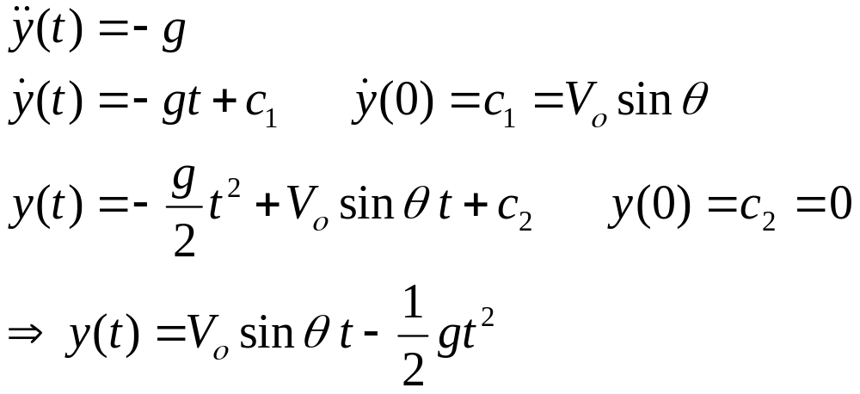
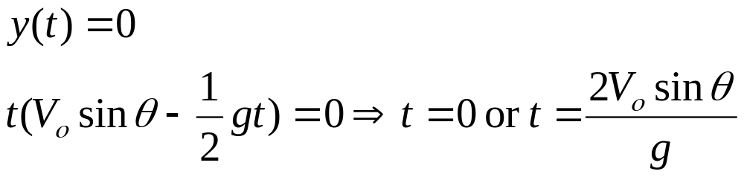
Solving your math problem
Shell reaches ground:

Slide 8
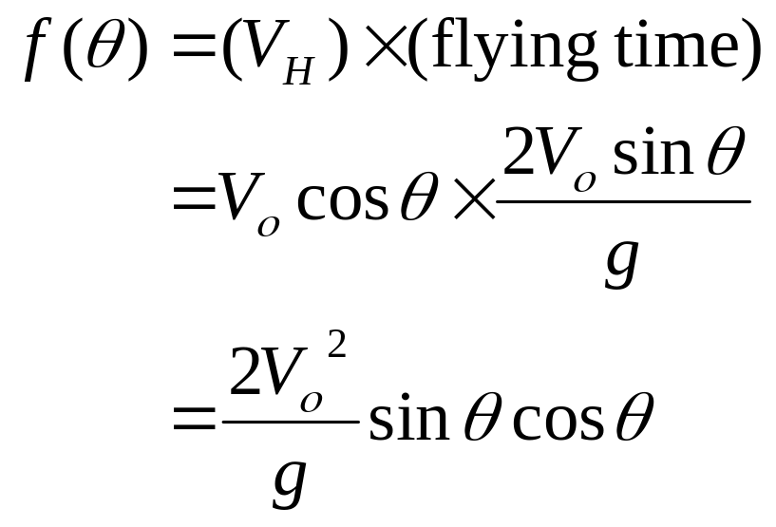
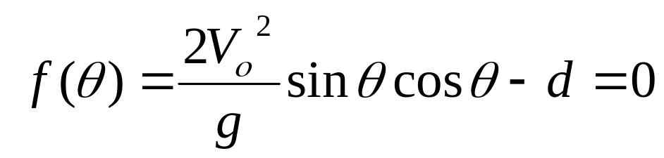
Solving your math problem (cont)
This is a nonlinear equation
We need to solve:

Slide 9
Remarks
The mathematical formulation is an idealization of the physical problem (for ease of solution)
  Air resistance not considered
  Ground not exact flat (earth is round)
  Coordinate system (height of canon not considered)

Slide 10
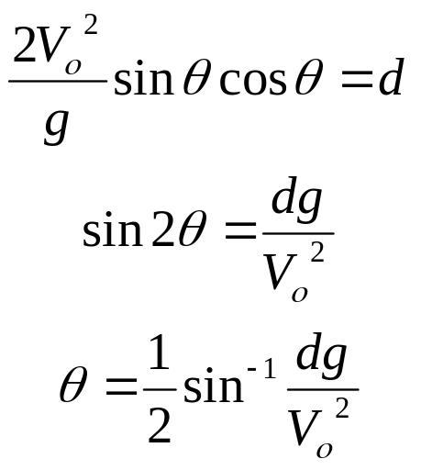
Remarks (cont)
This math problem has an exact solution; usually, it is not the case
Existence of solution?
  physically:
  mathematically:
Uniqueness of solution?

Slide 11
Solve the Problem Numerically
If the math problem has no analytic solution…
Consider the problem in the following general form:
  f(x) = 0
Many methods to choose from:
  Interval Bisection Method
  Newton
  Secant
  …

Slide 12
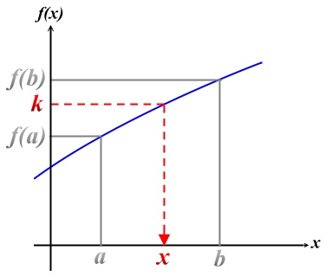
Interval Bisection Method
Recall the following theorem from calculus
Intermediate Value Theorem (中間值定理)
  If f(x) is continuous on [a,b] and k is a constant, lies between f(a) and f(b), then there is a value x∈[a,b] such that
  f(x) = k

Slide 13
Bisection Method (cont)
Simply setting k = 0
Observe:
  if sign( f(a) ) ≠ sign( f(b) )
  then there is a point x ∈[a, b] such that f(x) = 0

Slide 14
Definition
non-trivial interval [a,b]:
  f(a) ≠ 0, f(b) ≠ 0
  and
  sign( f(a) ) ≠ sign( f(b) )
  sign(-2) = -1
  sign(+5) = 1

Slide 15
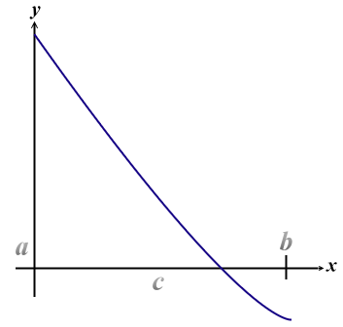
Idea
Start with a non-trivial interval [a,b]
Set c≡(a+b)/2
Three possible cases:
⑴ f(c) ＝ 0, solution found
⑵ f(c) ≠ 0, [c,b] nontrivial
⑶ f(c) ≠ 0, [a,c] nontrivial
Keep shrinking the interval until convergence
⑴ → problem solved
⑵⑶ → a new smaller nontrivial interval
_______
½ size

Slide 16
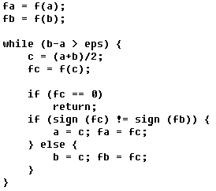
Algorithm
What’s wrong with this code?

Slide 17
Remarks
Convergence
  Guaranteed once a nontrivial interval is found
Convergence Rate
  A quantitative measure of how fast the algorithm is
  An important characteristics for comparing algorithms

Slide 18
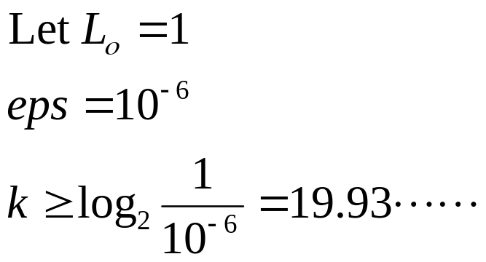
Convergence Rate of Bisection
Let:
  Length of initial interval L₀
  After k iterations, length of interval is L_{k}
  L_{k}=L₀/2^{k}
  Algorithm stops when L_{k} ≤ eps
Plug in some values…
This is quite slow, compared to the other methods…
Meaning of eps

Slide 19
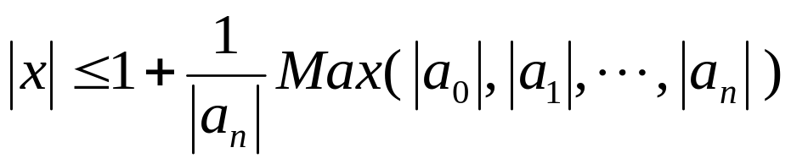
How to get initial (nontrivial) interval [a,b] ?
Hint from the physical problem
For polynomial equation, the following theorem is applicable:
  roots (real and complex) of the polynomial
  f(x) = a_{n}x^{n} + a_{n-1}x^{n-1} +…+ a₁x + a_{ο}
  satisfy the bound:

Slide 20

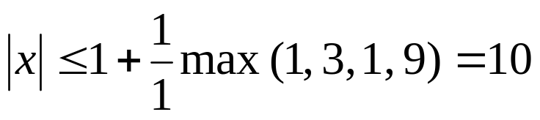
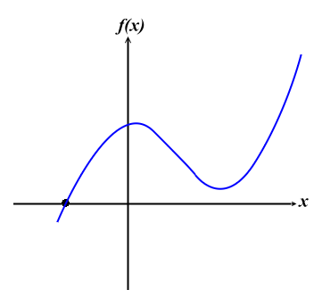
Example
Roots are bounded by
Hence, real roots are in [-10,10]
Roots are
–1.5251,
2.2626 ± 0.8844i
complex

Slide 21
Other Theorems for Polynomial Equations
Sturm theorem:
  The number of real roots of an algebraic equation with real coefficients whose real roots are simple over an interval, the endpoints of which are not roots, is equal to the difference between the number of sign changes of the Sturm chains formed for the interval ends.

Slide 22
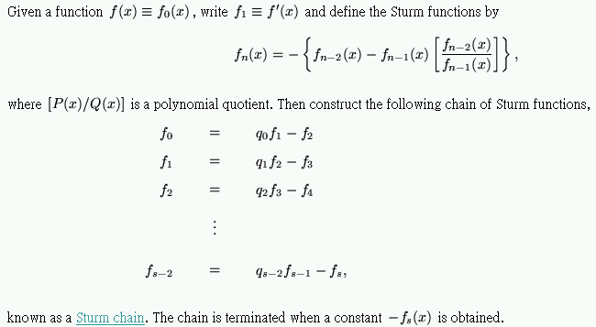
Sturm Chain

Slide 23
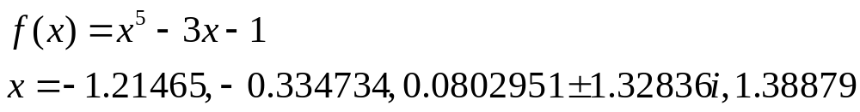
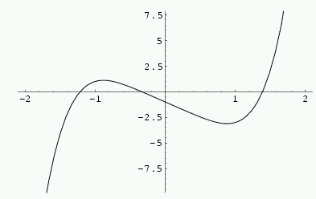
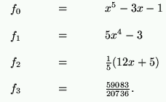
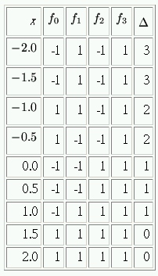
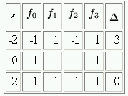
Example

Slide 24
Sturm Theorem (cont)
For roots with multiplicity:
  The theorem does not apply, but …
  The new equation : f(x)/gcd(f(x),f’(x))
    All roots are simple
    All roots are same as f(x)

Slide 25
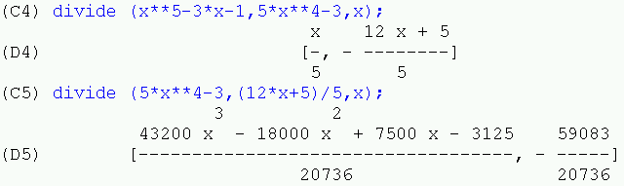
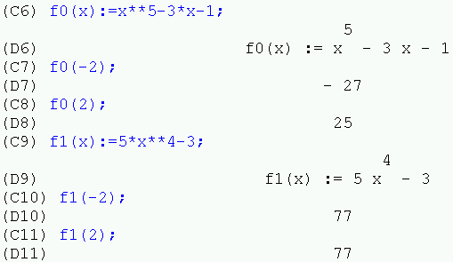
Sturm Chain by Maxima

Slide 26
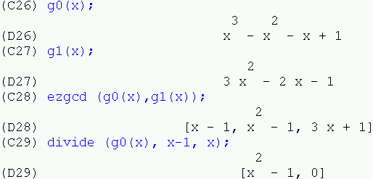
Maxima (cont)

Slide 27
Descarte’s Sign Rule
A method of determining the maximum number of positive and negative real roots of a polynomial.
For positive roots, start with the sign of the coefficient of the lowest power. Count the number of sign changes n as you proceed from the lowest to the highest power (ignoring powers which do not appear). Then n is the maximum number of positive roots.
For negative roots, starting with a polynomial f(x), write a new polynomial f(-x) with the signs of all odd powers reversed, while leaving the signs of the even powers unchanged. Then proceed as before to count the number of sign changes n. Then n is the maximum number of negative roots.
3 positive roots
4 negative roots

Slide 28
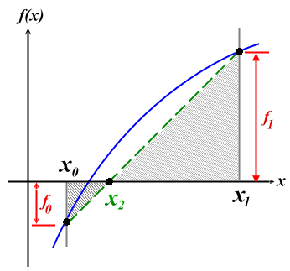
False Position Method
x₂ defined as the intersection of x axis and x₀f₀-x₁f₁
Choose [x₀,x₂] or [x₂,x₁], whichever is non-trivial
Continue in the same way as bisection
Compared to bisection:
  x₂=(x₁+x₀)/2

Slide 29
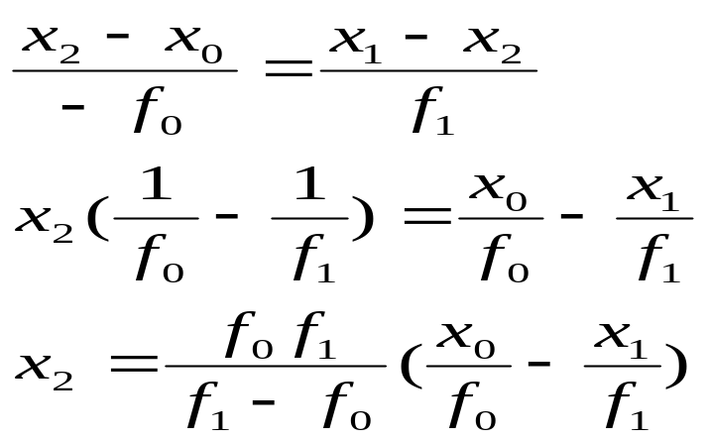
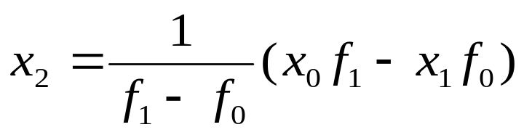
False Position (cont)
Determine intersection point
Using similar triangles:

Slide 30
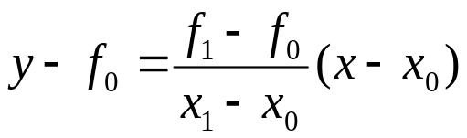
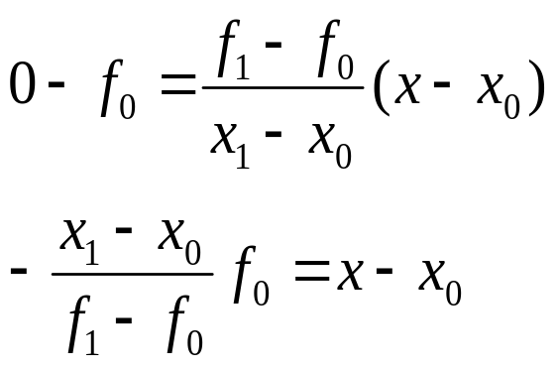
False Position (cont)
Alternatively, the straight line passing thru (x₀,f₀) and (x₁,f₁)
Intersection: simply set y=0 to get x
Notes:
Verify equivalence

Slide 31
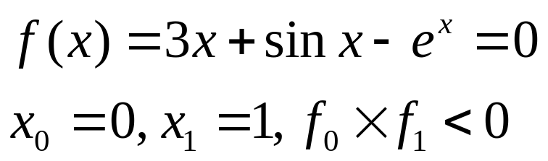
Example
k | x_{k} (Bisection) | f_{k} |  | x_{k} (False Position) | f_{k}
1 | 0.5 |  |  | 0.471
2 | 0.25 |  |  | 0.372
3 | 0.375 |  |  | 0.362
4 | 0.3125 |  |  | 0.360
5 | 0.34315 | -0.042 |  | 0.360 | 2.93×10⁻⁵

Slide 32
False Position
Always better than bisection?

Slide 33
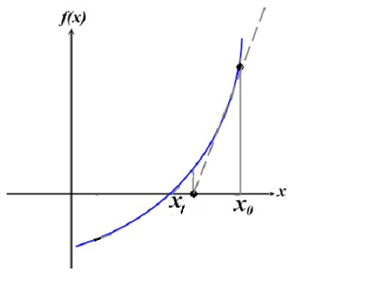

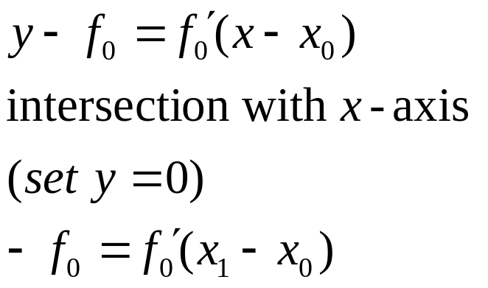
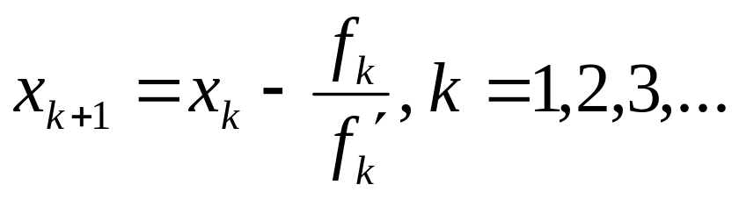
Newton’s Method
Graphical Derivation
tangent line thru (x₀ , f₀)
(x₀, f₀)

Slide 34
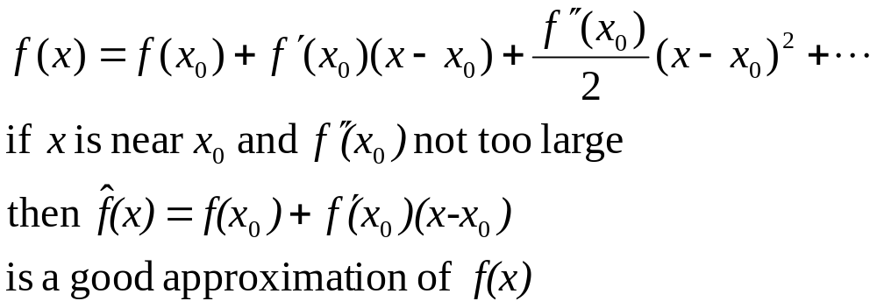
Newton’s Method (cont)
Derived using Taylor’s expansion

Slide 35
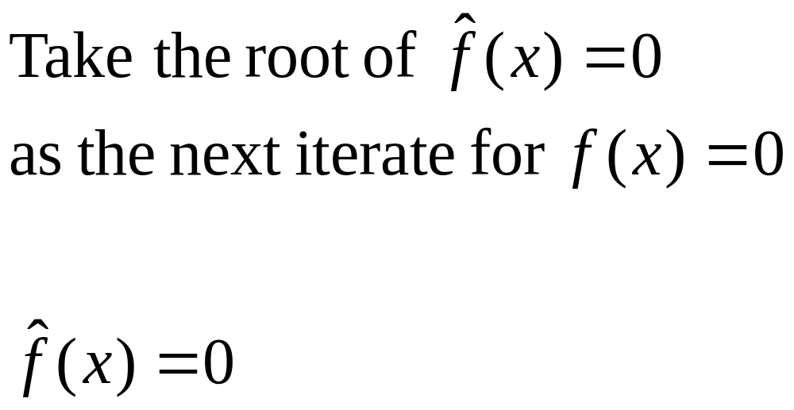
Taylor’s Expansion (cont)

Slide 36
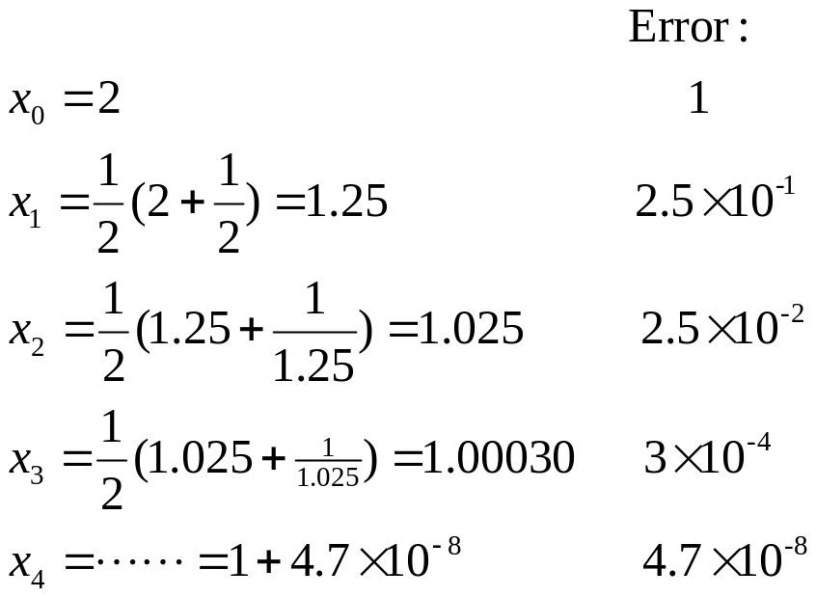
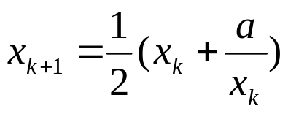
Example
Finding square root of 1 (a=1)
with x₀ = 2
Old Barbarians used the following formula to compute the square root of a number a
explain why this works:

Slide 37

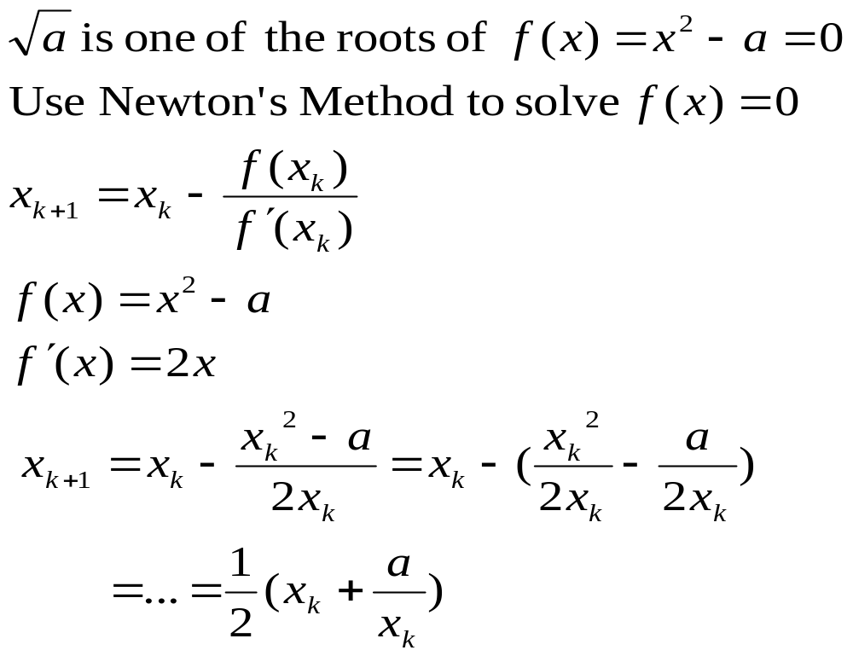
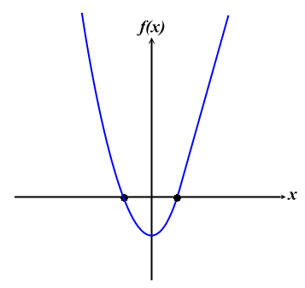
Newton’s Method

Slide 38
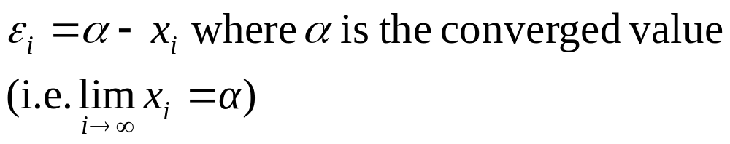
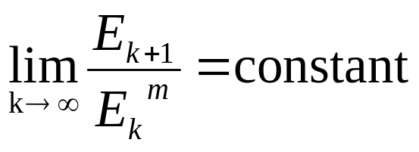
Definition
Error of the i^{th} iterate
Order of a method m, satisfies
where E_{k} is an error bound of ε_{k}

Slide 39
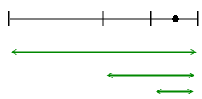
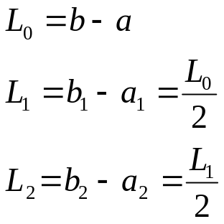
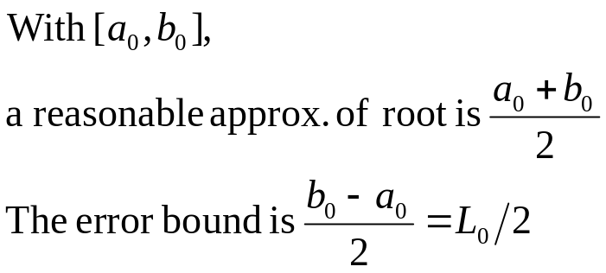
Linear Convergence of Bisection
root
L₀
a₀
b₀
L₁
a₁
b₁
L₂
a₂
b₂

Slide 40
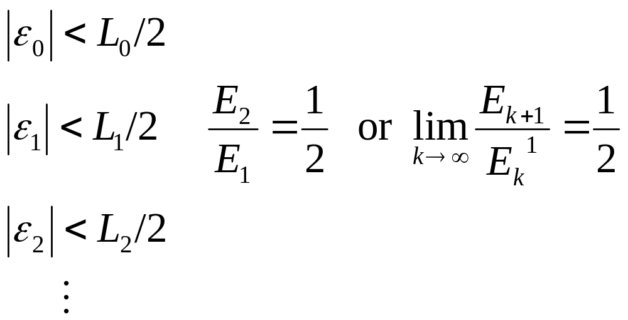
Linear Convergence of Bisection (cont)
We say the order of bisection method is one, or the method has linear convergence

Slide 41
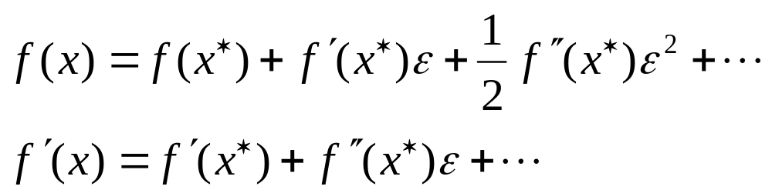
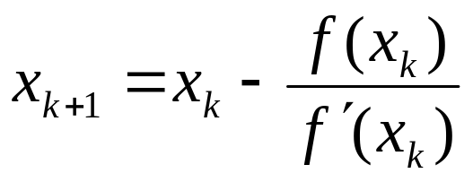
Quadratic Convergence of Newton
Let x* be the converged solution
Recall

Slide 42
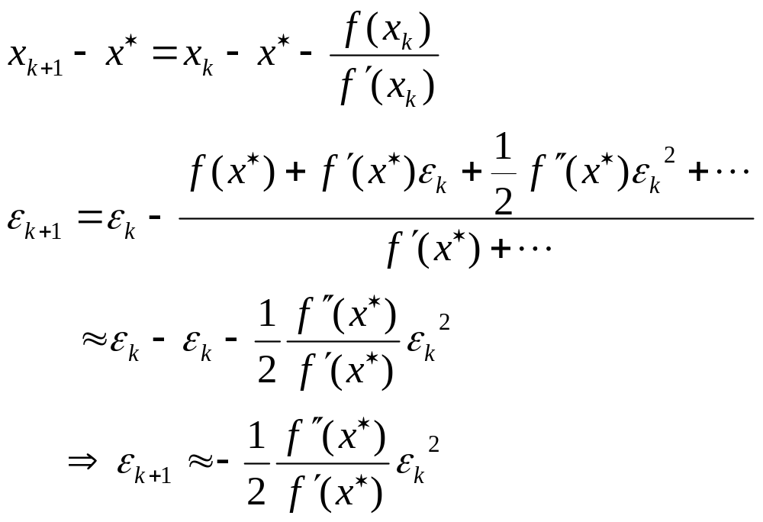
Quadratic Convergence of Newton (cont)
Subtracting x*:
Or we say Newton’s method has quadratic convergence

Slide 43
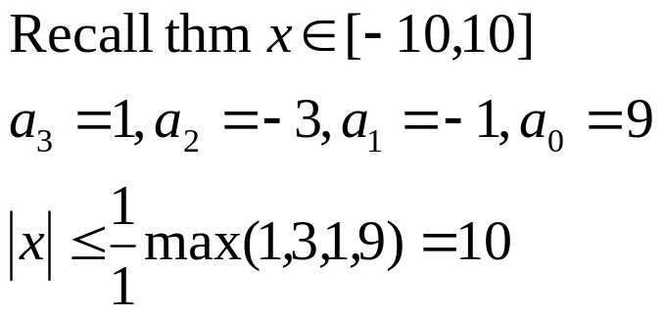
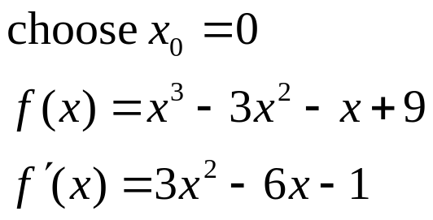

Example: Newton’s Method
f(x)= x³–3x² – x+9=0
k | x_{k}
0 | 0
1 | 9
2 | 6.41
46 | -1.5250
Worse than bisection !?

Slide 44
Why?
plot f(x)
Plot x_{k} vs. k
x_{k}
60
30
-1.525
10
5
-1.525
k
-10
25
35
40

Slide 45
Case 1:

Slide 46
Case 2:
Diverge to ∞

Slide 47

Recall Quadratic Convergence of Newton’s
The previous example showed the importance of initial guess x₀
If you have a good x₀, will you always get quadratic convergence?
  The problem of multiple-root

Slide 48


Example
Prove this!!
f(x)=(x+1)³=0
Convergence is linear near multiple roots

Slide 49
Multiple Root
If x* is a root of f(x)=0, then (x-x*) can be factored out of f(x)
  f(x) = (x-x*) g(x)
For multiple roots:
  f(x) = (x-x*)^{k} g(x)
  k>1 and g(x) has no factor of (x-x*)

Slide 50

Multiple Root (cont)
Implication:

Slide 51

Remedies for Multiple Roots
where k is the multiplicity of the root
Get quadratic convergence!
Problem: do not know k in advance!

Slide 52

Modified Newton’s Method

Slide 53

Modified Newton’s Method (cont)

Slide 54



Example
f(x)=(x–1)³sin((x – 1)²)

Slide 55

Quasi-Newton’s Method
Recall Newton:
The denominator requires derivation and extra coding
The derivative might not explicitly available (e.g., tabulated data)

Slide 56


Quasi-Newton (cont)
Quasi:
where g_{k} is a good and easily computed approx. to f’(x_{k})
The convergence rate is usually inferior to that of Newton’s

Slide 57

Secant Method
Order: 1.62
  Use the slope of secant to replace the slope of tangent
  Need two points to start

Slide 58
Idea:
x₂: Intersection of x-axis and a line interpolating x₀ f₀ & x₁ f₁
x₃: Intersection of x-axis and a line interpolating x₁ f₁ & x₂ f₂
x_{k+1}: Intersection of x-axis and a line interpolating x_{k-1}f_{k-1} & x_{k}f_{k}
‧
‧
‧
‧
x₂
x₁
x₀

Slide 59
Comparison
Newton’s method
False Position
‧
(Newton)
f ’(x_{k})
‧
‧
‧
‧
x_{k+1}
x_{k}

Slide 60
Beyond Linear Approximations
Both secant and Newton use linear approximations
Higher order approximation yields better accuracy?
Try to fit a quadratic polynomial g(x) thru the following three points:
    g(x_{i}) = f(x_{i}), i = k, k–1, k – 2
Let x_{k+1} be the root of g(x) = 0
  Could have two roots; choose the one near x_{k}
This is called the Muller's Method

Slide 61

Muller's Method
Order: 1.84
See Textbook
g(x) 通過 (x_{k-2}, f_{k-2}), (x_{k-1}, f_{k-1}), (x_{k},f_{k})

Slide 62

Finding the Interpolating Quadratic Polynomial g(x)
3 eqns to solve
unknowns：a₂ , a₁ , a₀
Double-check !
Or,

Slide 63
Summary
Iterative Methods for Solving f(x)=0
Basic Idea:
  Local approximation + iterative computation
  At k^{th} step, construct a polynomial p(x) of degree n, then solve p(x) = 0; take one of the roots as the next iterate, x_{k+1}
In other words,
  construct p(x)
  solve p(x) = 0; find the intersection between y=p(x) and x-axis
  choose one root

Slide 64

Revisit Newton
‧
p(x): is a linear approximation
passing thru(x_{k},f_{k}) with the slope
f_{k}‘
‧
x_{k+1}
x_{k}

Slide 65

Revisit Secant
p(x): is a linear approximation
passing thru (x_{k-1},f_{k-1}) and (x_{k},f_{k}) with the secant slope
p(x)
‧
‧
‧
‧
x_{k}
x_{k-1}

Slide 66
Revisit Muller
p(x) is a parabola (2nd degree approximation) passing thru three points
Heuristic: choose the root that is closer to the previous iterate
Potential problem:
  No solution (parabola and x-axis do not intersect!)

Slide 67
Categorize by Starting Condition
Bisection and False Position
  Require non-trivial interval [a,b]
  Convergence guaranteed
Newton: one point
  x₀ → x₁ →…
Secant: two points
  x₀ x₁ → x₂ → …
Muller: three points
  x₀ x₁ x₂ → x₃→ …
These methods converge faster but can diverge …

Slide 68

A Slightly Different Method:
Inverse Interpolation
Basic Idea (still the same)
  Local approximation + iterative computation
Method:
  At k^{th} step, construct a polynomial g(y) of degree n; then compute the next iterate by setting g(y = 0):

Slide 69

Inverse Linear Interpolation
Secant: Inverse linear Interpolation
y
‧
(x_{k-1}, f_{k-1})
‧
(x_{k}, f_{k})
x = g(y), x_{k+1}=g(0)
‧
x
(x_{k+1}, f_{k+1})

Slide 70

Inverse Quadratic Interpolation
Find another parabola:
  x = g(y)
Set the next iterate
  x_{k+1} = g(0)

Slide 71

Example (IQI)
Solve f(x)=x³–x=0
  x0 = 2, x1 = 1.2, x2 = 0.5

Slide 72
Professional Root Finder
Need guaranteed convergence and high convergence rate
Combine bisection and Newton (or inverse quadratic interpolation)
  Perform Newton step whenever possible (convergence is achieved)
  If diverge, switch to bisection

Slide 73
Textbook Reviews
Graphically determine order of method

